Slide 1
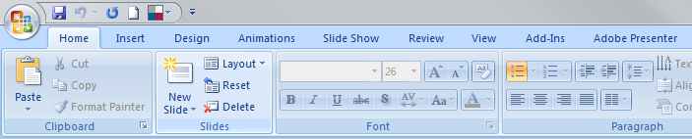
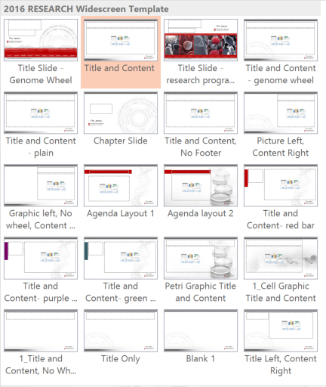
2016 OSUCCC – James Research Template
(16:9 widescreen format)
Create New Slides: Click on Home Tab > Click New Slide (in slides group)
Select best layout for your content
OR Apply Layout to Existing Slides:
Click on Home tab > Select Layout
Choose relevant layout for each slide then click Reset
Reset is below Layout. Click to reapply pre-formatted layouts to existing content

Slide 2
2016 OSUCCC – James Research Template
(16:9 widescreen format)
Add Old Slides to New Themed Presentation:
A. Drag slides from the old file
into James branded template
Open both the old file and the new themed file. Go to View tab> Window group> Arrange All to see the files side by side in PowerPoint. Grab thumbnails from old file and drag them over into the new file.
Follow Steps 2-5
Follow 4 steps for each slide you convert
Find your old slide(s) and add to your new template file (see option A or B)
Select correct Layout (Click Home tab, Slides group, Layout and choose relevant layout for content)
Reformat slide. Remove extra elements that came over from old file. Move text into Title & Content placeholders (if needed).
Click Reset (Click Home tab, Slides group and choose Reset)
Take a look at your slide. You still may need to do more cleanup and another click Reset.
B. Use the “ReUse Slides” feature
Click Home tab
Click on “New Slide” down arrow
Click on “Reuse” Slides
Insert slide from: Browse for your “old” presentation
Follow Steps 2-5

Slide 3
Research Presentation
Presenter’s name
Date

Slide 4
Research Presentation
Speaker Name
Date

Slide 5
Slide Title
Basic content placeholder

Slide 6
Slide Title
Basic content placeholder with corner design
For this slide option, the background design has decorative genome map

Slide 7
Slide Title
Basic content placeholder
For this slide option, the genome map and footer have been removed to accommodate complicated or detailed content
Do not allow content to go over the logo

Slide 8
Slide Title
picture
Basic content placeholder
picture

Slide 9
Slide Title
Basic content placeholder
Picture
goes here,
From just below the gray bar to bottom (over the footer).

Slide 10
Agenda
Agenda Item One
Agenda Item Two
Agenda Item Three
Agenda Item Four
Agenda Item Five

Slide 11
Agenda
Agenda Item One
Agenda Item Two
Agenda Item Three
Agenda Item Four
Agenda Item Five

Slide 12
Chapter / Divider slide

Slide 13
Slide Title Goes here
Point one
Point two
Point three

Slide 14
Slide Title Goes here
Point one
Point two
Point three

Slide 15
Slide Title Goes here
Point one
Point two
Point three

Slide 16
Slide Title
Point one
Point two
Point three
Notes:
16

Slide 17
Slide Title
Point one
Point two
Point three

Slide 18
Slide Title

Slide 19
Thank You
To learn more about Ohio State’s cancer program, please visit cancer.osu.edu or follow us in social media:

